Slide 1
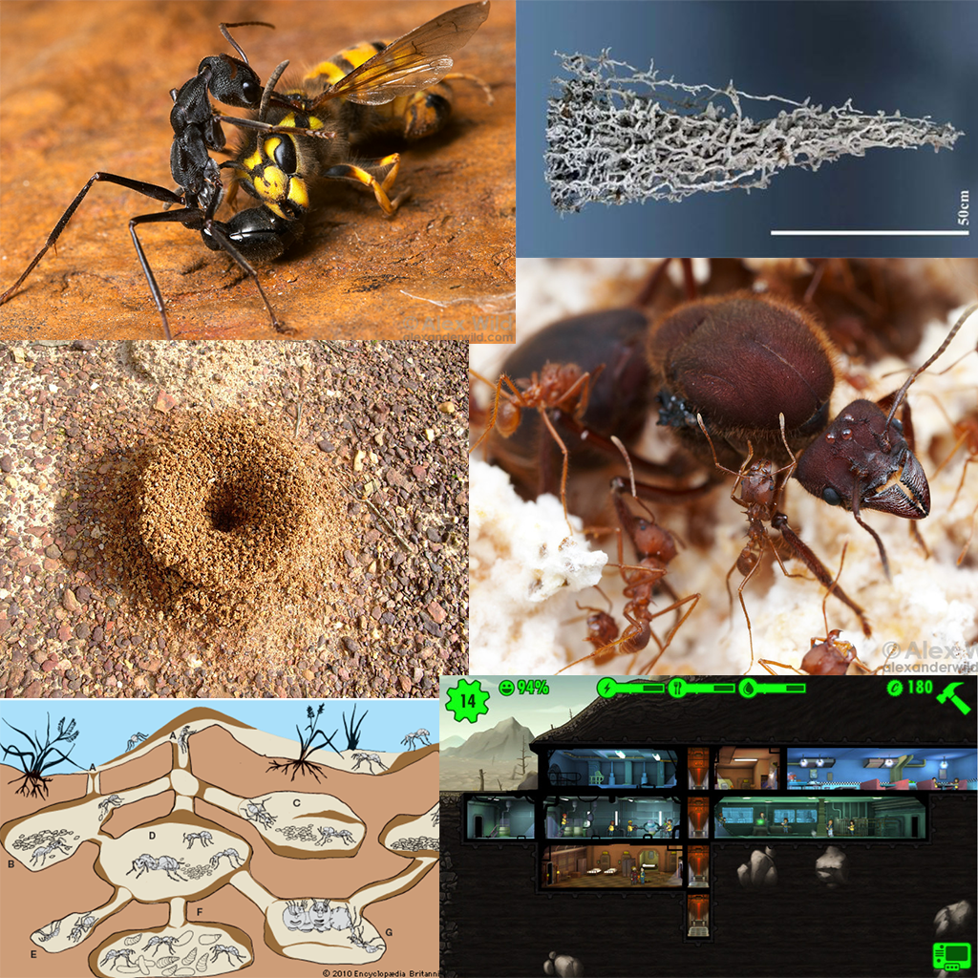
Managerial colony game concept
Figure 3

Slide 2
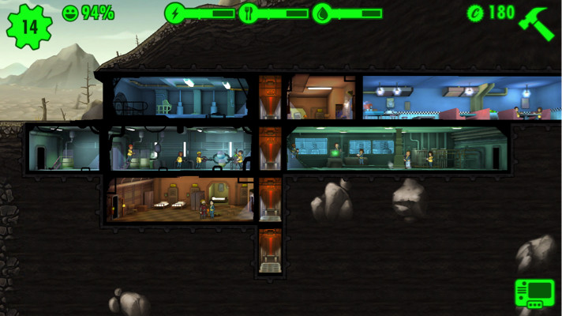
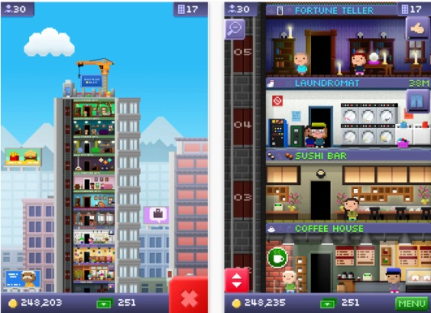
Research
Core Loops and Compulsion Loops in Managerial Idle Games
Notes:
Discuss the key features of managerial idle games, especially the compulsion loops (especially fun pain). With special relation to Fallout Shelter and Tiny Towers.

Slide 3
Core Loop
Trigger: Previous tasks complete (Notification)
Action: Select completed task prompts
Reward: In game currencies/resources
Investment: Spend currencies/resources on setting new tasks to be carried out
Notes:
Briefly go over the key elements of a compulsion loop and explain how managerial idle games tend to accomplish this. With special reference to how the different elements are presented in Fallout Shelter, Tiny Towers and the pitched game.

Slide 4
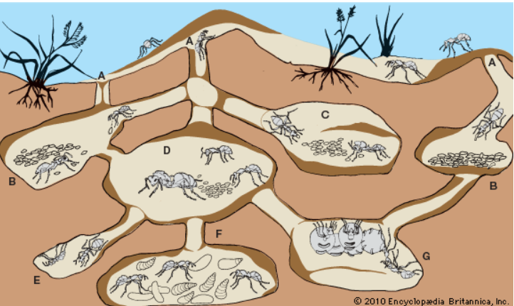
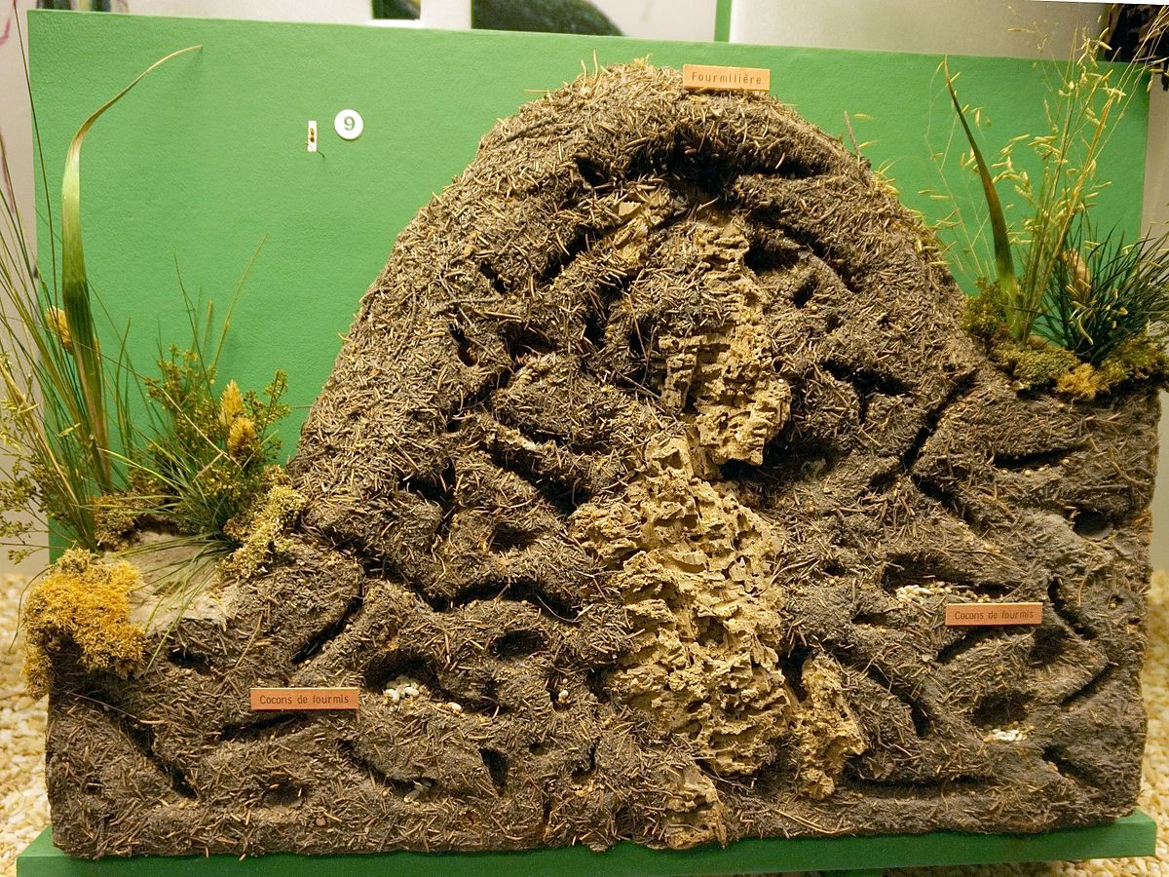
Theme
Ant Hives
Notes:
Explain the theme of the game. Hives can be built with modular rooms as in Fallout Shelter to allow for ever expanding play, ants have drone like responsibilities that fit in well with the game, the knowledge of ants building hives is well known enough that powerful affordances can be created.

Slide 5
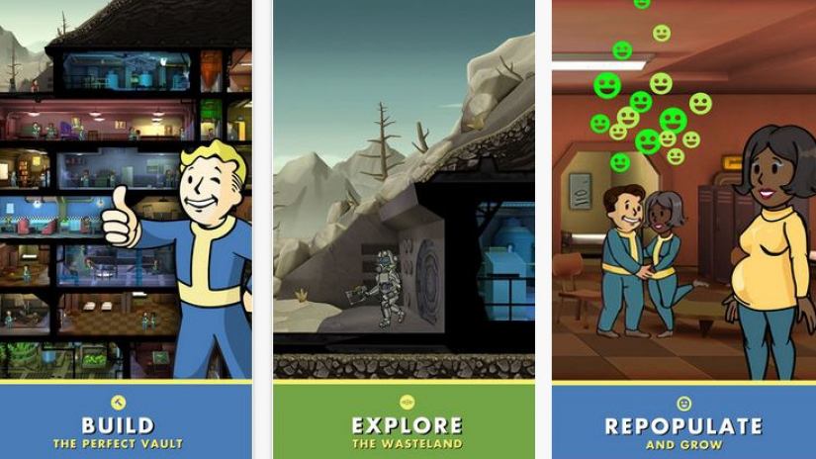
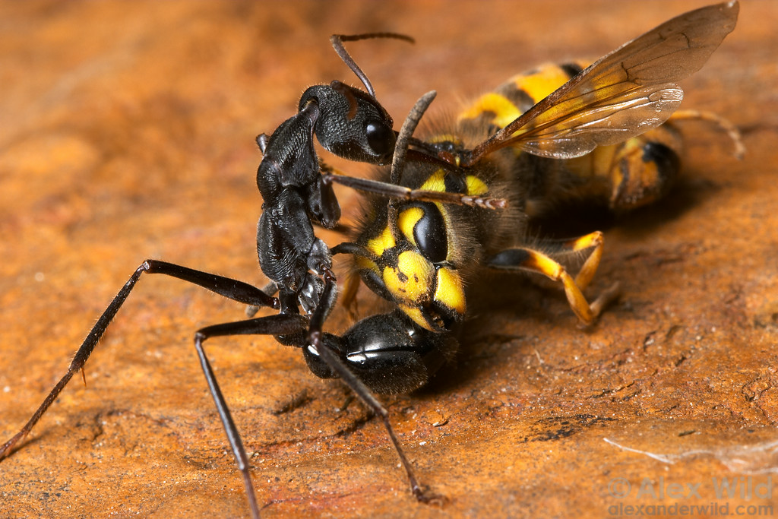
Additional Loop
Additional Management based compulsion loops
Notes:
Explain how both Tiny Towers (and especially) Fallout Shelter have additional loops to draw players in (Shelter has breeding and exploring mechanics entirely based around management (Real time and idle respectively)). Then explain how at least one additional loop will reinforce the core loop and what that loop would be. (Relate to design document)

Slide 6
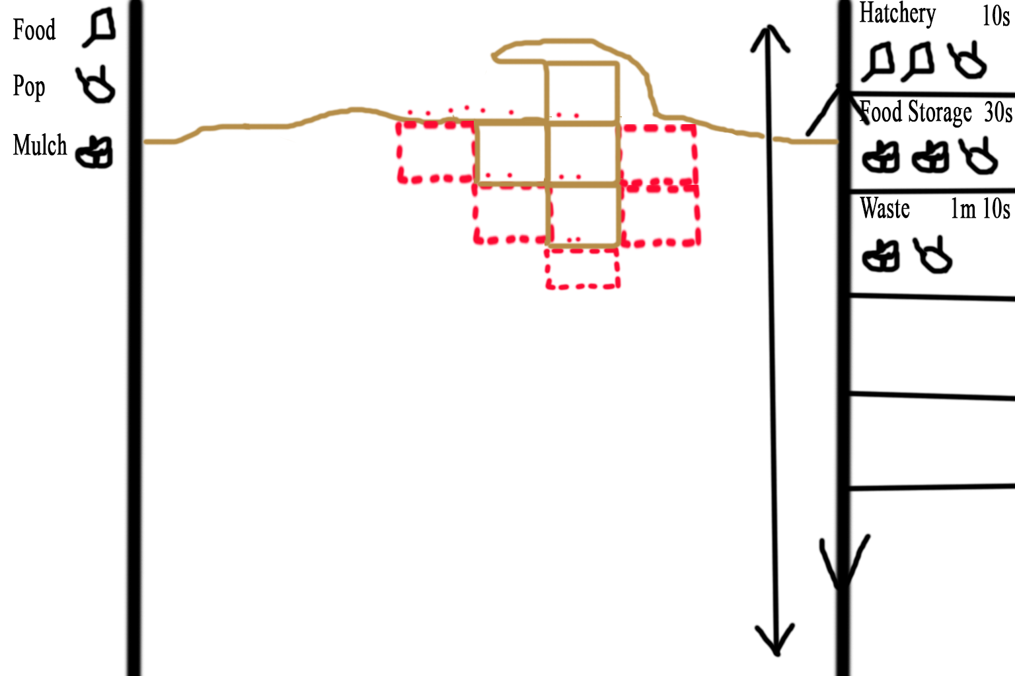
Game Screen Mock Up
Notes:
Talk through the UI and how players are able to interact with the screen. Middle and right panels can be scrolled up and down. Left Panel displays current resources and possibly other statistics about the hive. Right panel shows tasks that can be started (Rooms that can be constructed) with the resource cost and the amount of real time the task will take to complete, if the player selects a room task that they can afford the red outlines appear in the middle panel showing where the room can be constructed, the player must select one of the outlines for the task to begin. The Middle panel shows the hive with the ant population performing animations according to their current task and all the different rooms that have been constructed. Players will be shown tasks that are finished and can select them to receive the rewards. Finished rooms that produce a resource must be worked by the population, by selecting a room that does not have a completed task will disable the room so that the population in it will return to the resource pool, a disabled room can be enabled again by selecting it if there are enough ants to begin working it again. Working rooms periodically finish constructing resources and must be selected by the player to receive the reward and get the room working again.

Slide 7
Early concept work and Prototype
Include concept art and video footage.

